Slide 1

Legacy Databases
www.pdbmbook.com

Slide 2
Introduction
Hierarchical Model
CODASYL Model

Slide 3
Hierarchical Model
The hierarchical model originated during the Apollo program conducted by NASA
  IBM developed the Information Management System or IMS DBMS (1966-1968)
No formal description available and lots of structural limitations (legacy)
Two key building blocks: record types and relationship types

Slide 4
Hierarchical Model
A record type is a set of records describing similar entities and has 0, 1 or more records
  Examples: product record type, supplier record type
A record type consists of fields or data items
  Examples: product number, product name, product color

Slide 5
Hierarchical Model
A relationship type connects two record types
Only hierarchical structures are allowed (1:N relationship types)
A record type can be a parent in multiple parent/child relationship types, but it can participate in at most one relationship type as a child
Relationship types can be nested
Root record type sits as the top of the hierarchy, whereas leaf record type sits at the bottom

Slide 6
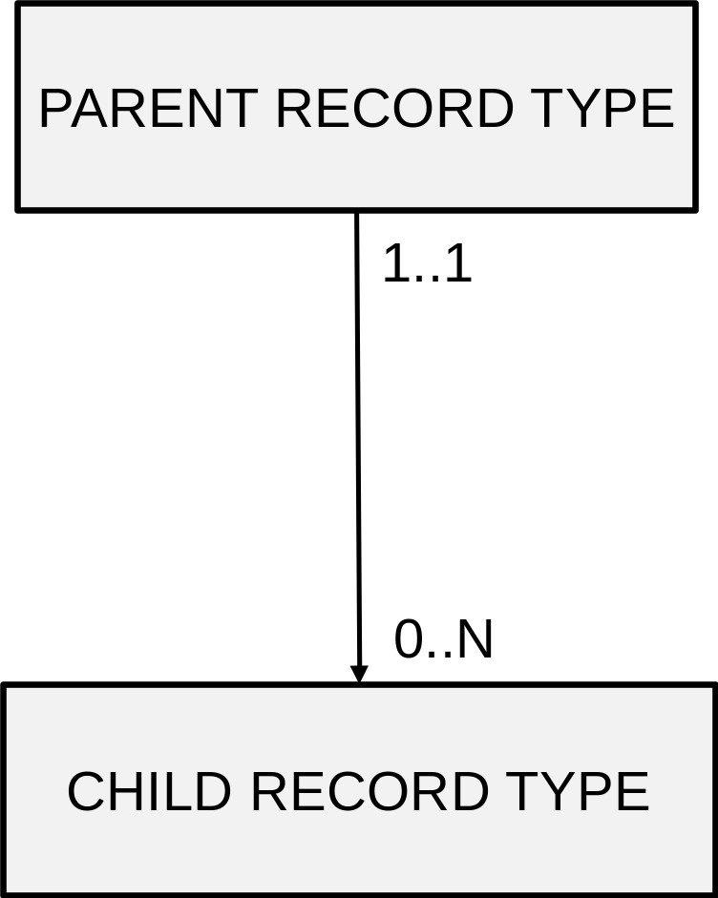
Hierarchical Model
1:N relationship type!

Slide 7
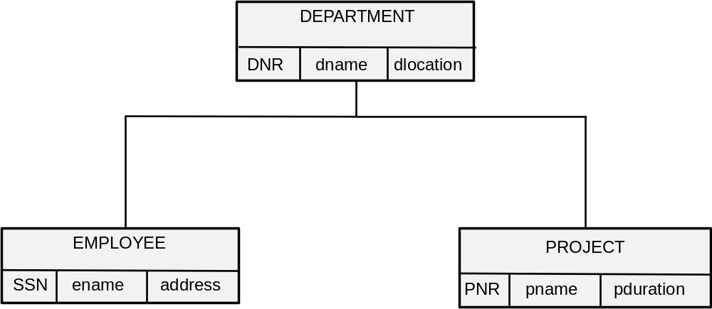
Hierarchical Model

Slide 8
Hierarchical Model
All data needs to be retrieved by navigating down from the root node (procedural DML)
The hierarchical model is also very rigid and thus limited in terms of expressive power
No support for N:M or 1:1 relationship types
N:M relationship type
  assign one record type as the parent and the other as the child record type
  put relationship type attributes in child record type
  however: redundancy is introduced!

Slide 9
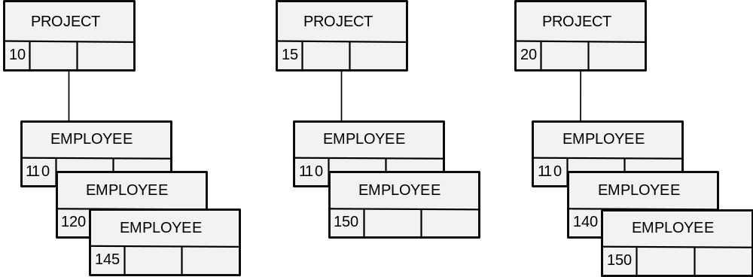
Hierarchical Model

Slide 10
Hierarchical Model
Another option for an N:M relationship type is to create two hierarchical structures and connect them using a virtual child record type and a virtual parent/child relationship type
  pointers can then be used to navigate between both structures
  relationship type attributes can be put in the virtual child record type
  no more redundancy

Slide 11
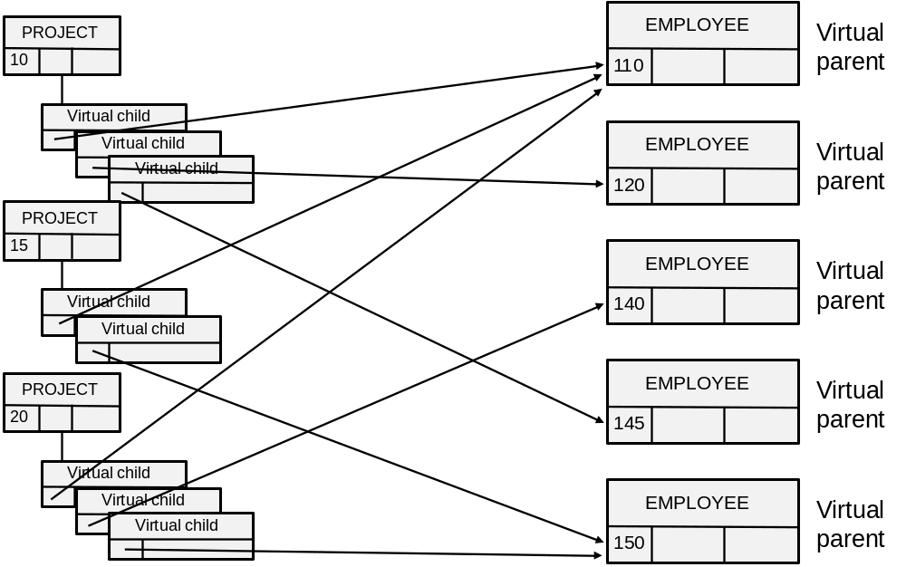
Hierarchical Model

Slide 12
Hierarchical Model
1:1 relationship types should be implemented in application programs
The hierarchical model only allows relationship types of degree 2
  Recursive relationship types or relationship types with more than 2 record types need to be implemented using virtual child record types
A child can not be disconnected from its parent (on delete cascade)

Slide 13
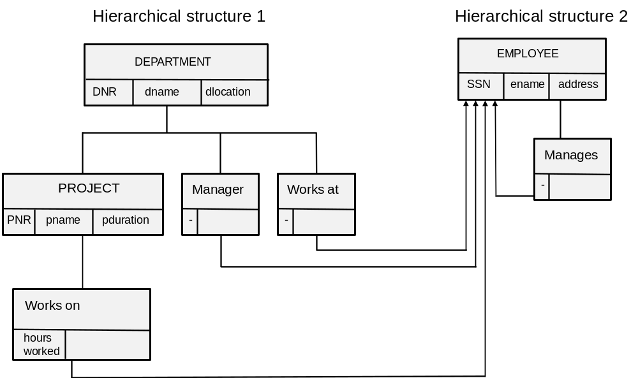
Hierarchical Model

Slide 14
Hierarchical Model
Model limitations
  no guarantee that each department has exactly 1 manager
  no guarantee that a department has at least 1 employee

Slide 15
CODASYL Model
The CODASYL model was developed by the Data Base Task Group of the COnference on DAta SYstem Languages in 1969
CA-IDMS (Computer Associates)
Building blocks
  record types
  set types
Lots of structural limitations (legacy)

Slide 16
CODASYL Model
A record type is a set of records describing similar entities and has 0, 1 or more records or record occurrences
A record type consists of various data items
A vector is a multivalued attribute type
  Example: e-mail address
A repeated group is a composite data item for which a record can have multiple values or a composite multi-valued attribute type
  Example: address

Slide 17
CODASYL Model
A set type models a 1:N relationship type between an owner record type and a member record type
A set occurrence has 1 owner record and 0, 1 or more member records
A CODASYL set has both owner and member records and it is also possible to order the member records (↔ mathematical set)

Slide 18
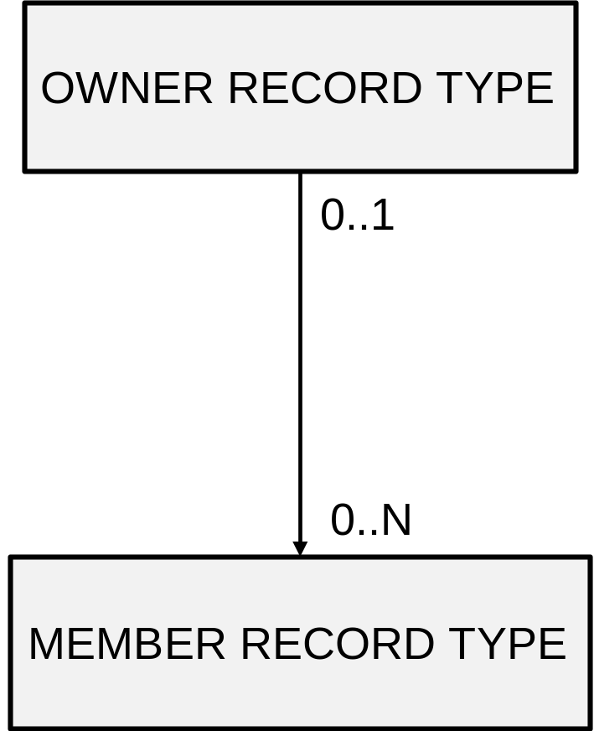
CODASYL Model

Slide 19
CODASYL Model
A member record can exist without being connected to an owner record
A record type can be a member record type in multiple set types (network structures)
Multiple set types may be defined between the same record types

Slide 20
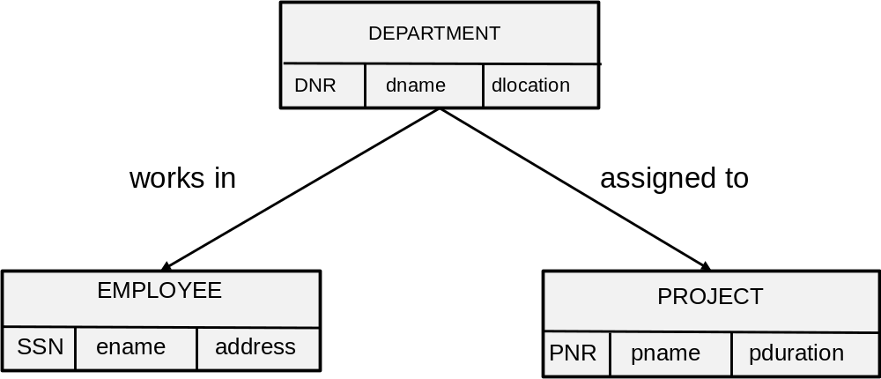
CODASYL Model
Bachmann diagram

Slide 21
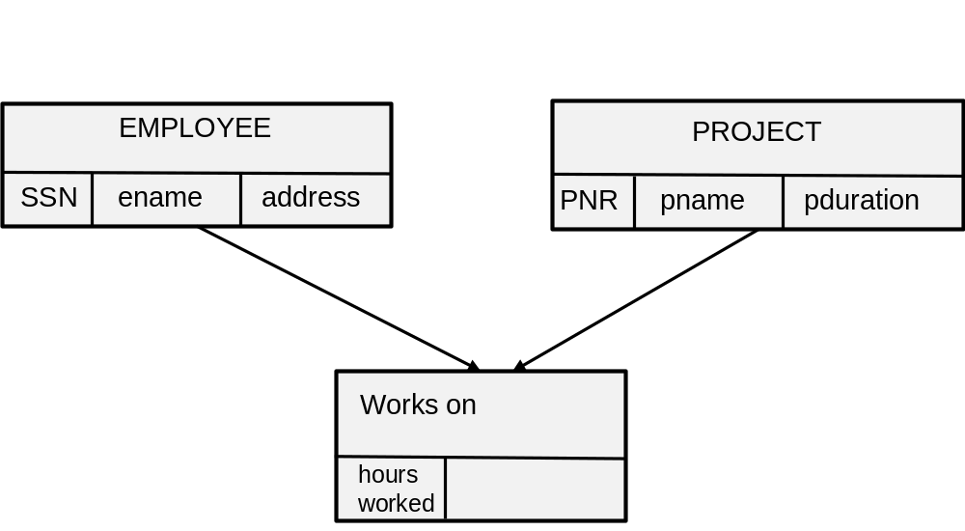
CODASYL Model
1:1 relationship types must be enforced in the application program
N:M relationship types
  introduce a dummy record type as a member record type in 2 set types having as owners the record types of the original N:M relationship type

Slide 22
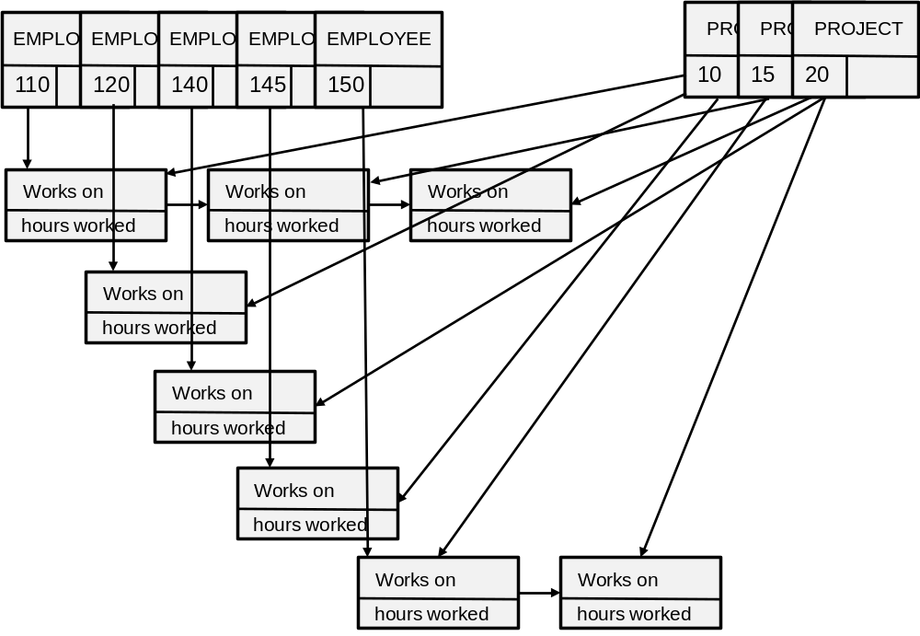
CODASYL Model
Procedural DML!

Slide 23
CODASYL Model
CODASYL allows to logically order the member records of a set (e.g., alphabetically)
System can act as the owner for the root record type (singular or system owned set type)
No support for recursive set types
  dummy record type needs to be introduced
No set types with more than 2 participating record types

Slide 24
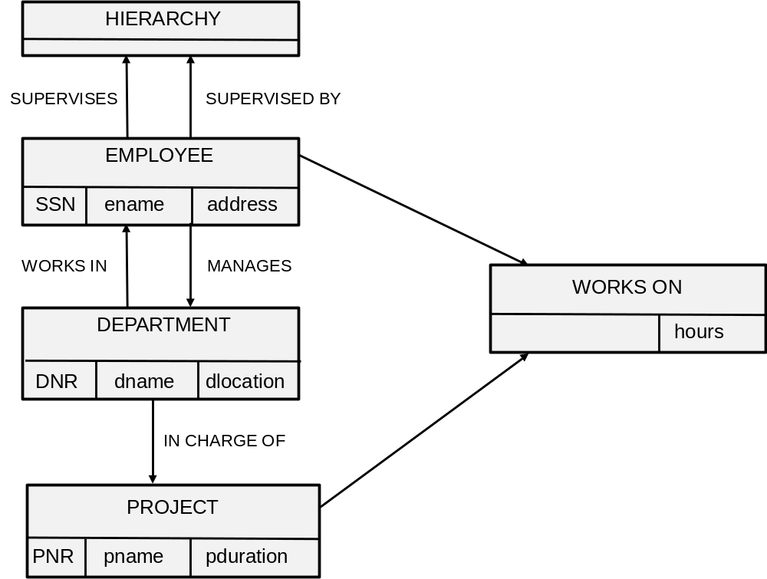
CODASYL Model

Slide 25
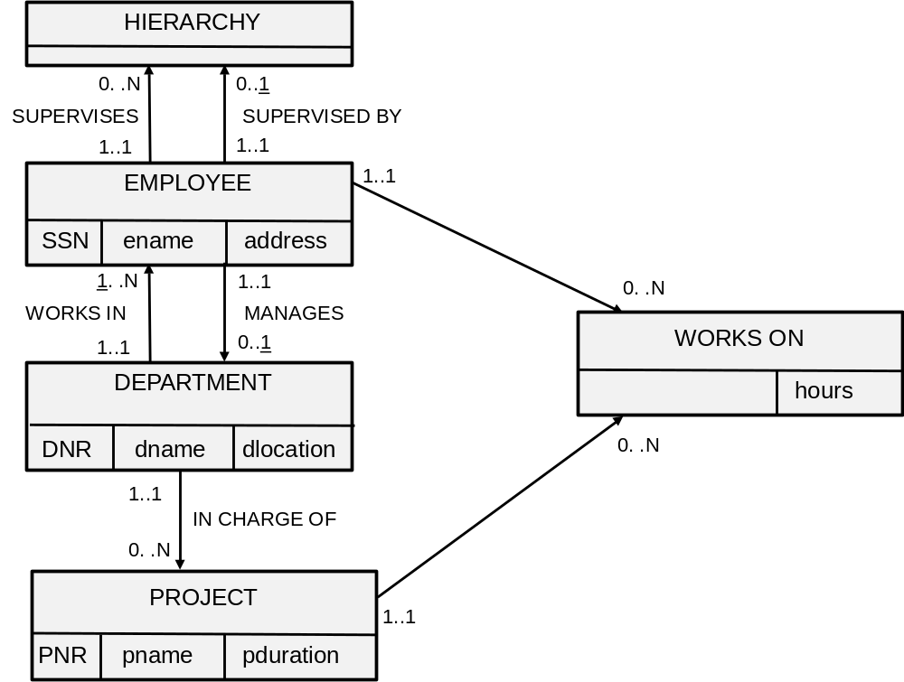
CODASYL Model

Slide 26
CODASYL
Model limitations
  an employee can be managed by multiple employees
  no guarantee that a department must have exactly 1 manager
  no guarantee that a department has minimal one employee

Slide 27
Conclusion
Hierarchical Model
CODASYL Model

Slide 28
More information?
www.pdbmbook.com

